Slide 1

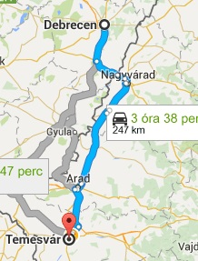
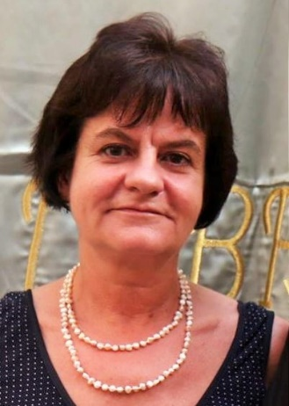
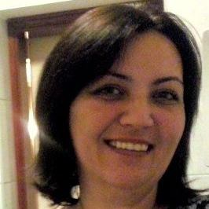
HUNGARY: just the first steps
Coming from the borderline and hypnosis field (treating, teaching, giving
supervision, publishing and conducting research)
Complex trauma and dissociation are not widely known in Hungary, so we
based our work on international literature (outstanding on O. van der Hart’s structural
dissociation theory), and on our clinical experiences.
24-25 April 2015 Timisoara: Attending the First Conference of ESTD in Romania - Many thanks to Anca Sabau!
Becoming members of the ESTD – the much-needed support
Our contribution to the increase of knowledge on trauma and dissociation
In Hungary:
Books and articles published on childhood traumatization (2015),
Editing and writing a book on trauma-related dissociaton ( in progress)
Translating The Haunted Self into Hungarian (in progress)
Supervisions for clinicians working with patients with complex PTSD for many years
Conference with Eli and Liora Somer, Debrecen, 21-22.10. 2016 (and will be continued…)
Ildiko Szabo Kuritarne PhD
associate professor
szabo.ildiko@sph.unideb.hu
Judit Molnar PhD
assistant professor
mojudit@gmail.com
fotó
fotó
University of Debrecen,
Institute of Behavioural Sciences

